Slide 1

Folding | Packing |Packaging Guide
Product Team
Institution Business
1/16/2019

Slide 2

SHIRT

Slide 3
Shirt – Packing Trims
SHIRT FOLDING & PACKING MATERIAL SPECIFICATION
Sr. No. | Material | Specification | Required qty. per Garment / Placements | Image
1 | Collar Patti | 700 GSM, 36 cm x 3 cm with cutting dot | 1 pc / Inside collar band
2 | Collar Traveller | Transparent 46 cm x 3.5 cm | 1 pc / Inside collar
3 | Double Butter Fly | Transparent 13.5 cm x 7 cm | 1 pc / At collar band button
4 | Butter Paper | Plain 50 cm x 38 cm | 1 pc / Refer folding step 2

Slide 4
Shirt – Packing Trims
SHIRT FOLDING & PACKING MATERIAL SPECIFICATION
Sr. No. | Material | Specification | Required qty. per Garment / Placements | Image
5 | Back support | 800 GSM 35 cm x 22 cm | 1 pc / Refer folding step 3
6 | ‘M’ Clip | As per image 3.5 cm x 2 cm | 1 pc / At folding shoulder joint
7 | ‘U' Clip | As per image 4.3 cm | 3 pcs / 2 pc at back fold & 1 at cuff
8 | Belly Band | Printed 9 ½” length, width ½” | 1 pc / 3'' above bottom fold

Slide 5

Shirt – Packing Trims
SHIRT FOLDING & PACKING MATERIAL SPECIFICATION
Sr. No. | Material | Specification | Required qty. per Garment / Placements | Image
9 | Corporate Tag | 12.5 x 9 cm Fold mark at 6.3 cm with Kimble hole on top left corner | 1 pc / 2nd buttonhole of front placket
10 | Barcode Sticker | - | 1 pc / on back of Corporate Tag
11 | Kimble | Black 13 cm length with lock groove | 1 pc / For corporate Tag
12 | Size Tag | 11 cm x 3 cm based on collar size to be folded | 1 / Centre of back, SIZE should be visible

Slide 6

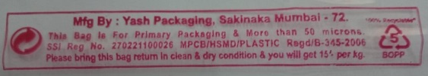
Shirt – Packing Trims
SHIRT FOLDING & PACKING MATERIAL SPECIFICATION
Sr. No. | Material | Specification | Required qty. per Garment / Placements | Image
12 | Poly Bag | Poly 41 cm x 26 cm, Top side 2.5 cm Gusset, Folding extension 5 cm. | 1 / Gusset / should be at top of collar [Poly bag warning instruction mandatory refer insert] it should be in red color.

Slide 7

Shirt – Plastic polybag Mandate
Instruction :
All Polybags needs to be upgraded to 55 microns with below note at back of Polybag :
This bag is mfg & mkt by : Address, phone no, & email id
This bag is made of 100% virgin material & is 100% recyclable. Above 51+ microns.
License no :
This bag is for Industrial and Integral Packaging Only. Buy Back price for empty clean bags Rs.15/- per kg
PRINT PLACEMENT :
Vertical Placement of print – 6.5” from bottom
Horizontal Placement of print – 5.5” from sides

Slide 8

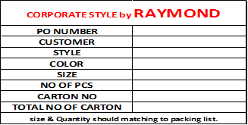
Shirt – Packaging Trims
SHIRT FOLDING & PACKING MATERIAL SPECIFICATION
Sr. No. | Material | Specification | Required qty. per Garment / Placements | Image
12 | Carton Box | 7 ply / Length 20” X Width 15” X Height 21” / 30 Pcs per Carton | 30 pcs in 1 Carton
13 | Carton sticker | A4 | 1 pc per Carton / Place at center of width of carton
21”
15”
20”

Slide 9
Shirt – Folding Sequence
STEP-1 [Lay on the table facing back towards viewer] | STEP-2 [Place Butter Paper] | STEP-3 [Place Collar Patti inside Collar Stand and place Back Support]

Slide 10
Shirt – Folding Sequence
]
STEP-4 [Fold Left of Front] | STEP-5 [Fold Left Sleeve] | STEP-6 [Fold Right of Front]

Slide 11
Shirt – Folding Sequence
STEP-7 [Attach 'M' Clip at Shoulder joint] | STEP-8 [Fold Bottom] | STEP-9 [Fold Body Half]

Slide 12
Shirt – Folding Sequence
STEP-10 [Place 'U' Clips at Bottom Fold] | STEP-11 [Place Wearer’s Right Cuff with ‘U’ Clip] | STEP-12 [Place Belly Band 3” above Bottom]

Slide 13
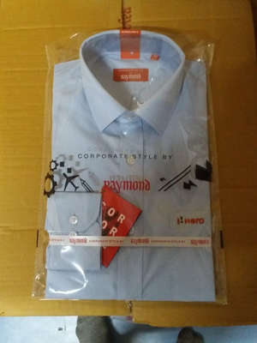
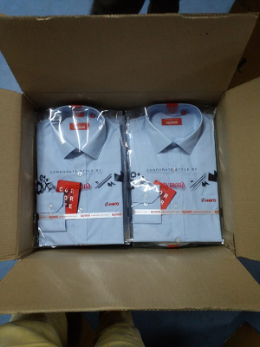
Shirt – Packing & Packaging Sequence
STEP-13 [Attach Hang Tag at 2nd Button Hole of front placket, Insert Polybag] | STEP-14 [Place two pcs parallel inside carton box] | STEP-15 [Close & tape the carton and place carton sticker at center of width of carton]

Slide 14
TROUSER

Slide 15
Trouser – Packing Trims
SHIRT FOLDING & PACKING MATERIAL SPECIFICATION
Sr. No. | Material | Specification | Required qty. per Garment/Placements | Image
1 | U' Clip | As per image 4.3cm | 3 & 4 pcs / Up to 34 size 2 [1 at front & 1 at center of waist] 36 to 50 size 3 [1 at front fold, 1 at back fold & 1 at center of waist]
2 | Corporate Tag | 12.5 x 9 cm Fold mark at 6.3 cm with Kimble hole on top left corner | 1pc / Top side seam loop
3 | Barcode Sticker | - | 1 pc / on back of Corporate Tag
4 | Kimbel | Black 13 cm length with lock groove | 1 pc

Slide 16

Trouser – Packing Trims
SHIRT FOLDING & PACKING MATERIAL SPECIFICATION
Sr. No. | Material | Specification | Required qty per Garment/Placements | Image
5 | Size Tag | 7.5 cm x 8.8 cm Fold mark on 6 cm | 1 pc / Centre of welt pocket
6 | Poly Bag for 4 fold | Poly bag 44 cmx 36 cm, Folding extension 4 cm. | 1pc / [Poly bag warning instruction mandatory refer insert] its / be red color.

Slide 17
Trouser – Plastic polybag Mandate
Instruction :
All Polybags needs to be upgraded to 55 microns with below note at back of Polybag :
This bag is mfg & mkt by : Address, phone no, & email id
This bag is made of 100% virgin material & is 100% recyclable. Above 51+ microns.
License no :
This bag is for Industrial and Integral Packaging Only. Buy Back price for empty clean bags Rs.15/- per kg
PRINT PLACEMENT :
Vertical Placement of print – 6.5” from bottom
Horizontal Placement of print – 5.5” from sides

Slide 18
Trouser – Packaging Trims
SHIRT FOLDING & PACKING MATERIAL SPECIFICATION
Sr. No. | Material | Specification | Required qty per Garment/Placements | Image
8 | Carton Box for 2 fold packing | 7 ply/Length 24” X Width16” x Height 14”, 40 pcs per Carton | 1 carton 40 pcs.
9 | Carton Box for 4 fold packing | 7 ply / Length 24'‘ X Width 16'‘ X Height 14'' 40 pcs per Carton | 1 carton 40 pcs.
10 | Carton sticker | A4/place at center of width of carton | 1
14”
16”
24”
14”
24”
16”

Slide 19
Trouser – Folding Sequence – Four Fold
STEP-1 [Lay on the table centre fold] | STEP-2 [Half fold vertically] | STEP-3 [Another half fold vertically]

Slide 20
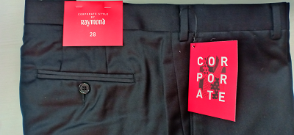
Trouser – Packing Sequence – Four Fold
STEP-4 [Attach Hangtag and Size Tag] | STEP-5 [Put inside the polybag] | STEP-6 [Put inside the carton]

Slide 21
Trouser – Packaging Sequence – Four Fold
STEP-7 [Close & tape the carton and place carton sticker at center of width of carton]

Slide 22
JACKET

Slide 23
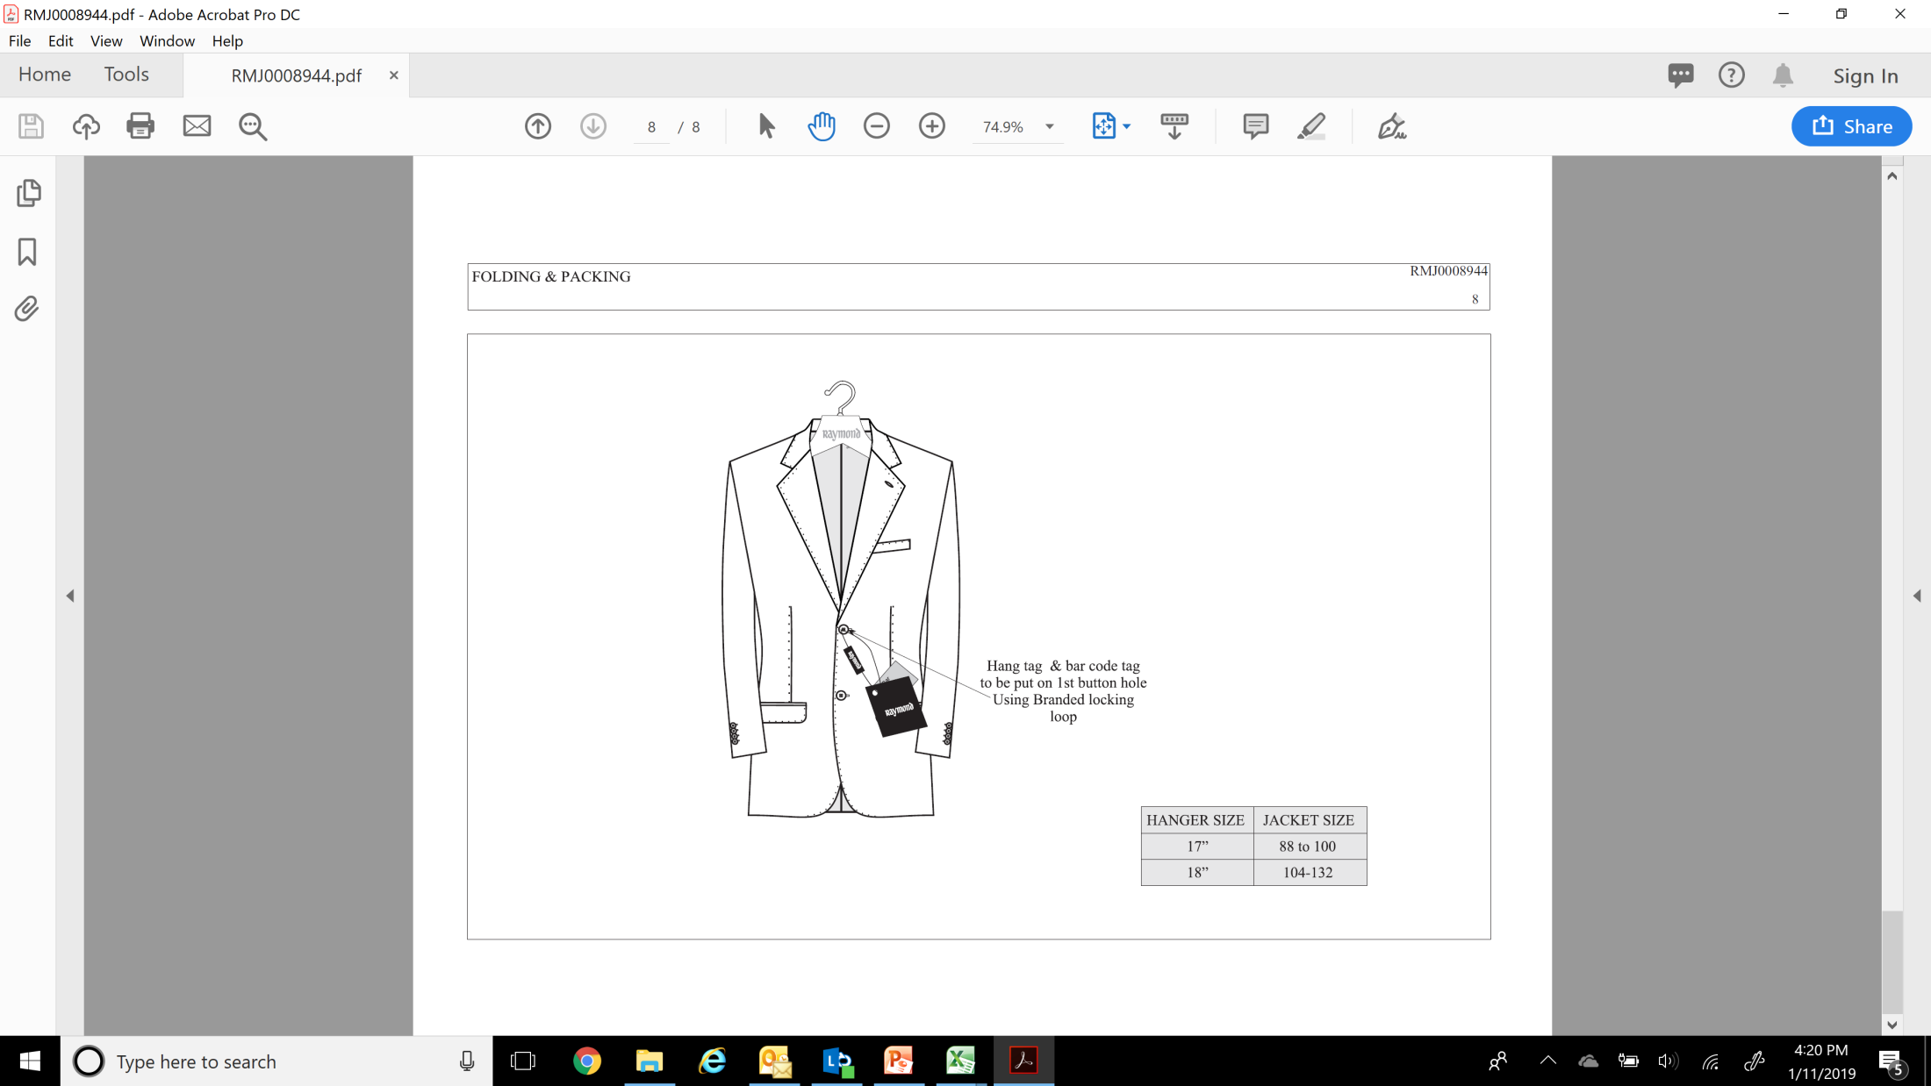
Jacket – Packing Trims
SHIRT FOLDING & PACKING MATERIAL SPECIFICATION
Sr. No. | Material | Specification | Required qty. per Garment / Placements | Image
1 | Corporate Tag | 12.5 x 9 cm Fold mark at 6.3 cm with Kimble hole on top left corner | 1pc / 1st Front Button Hole
2 | Barcode Sticker | - | 1 pc / on back of Corporate Tag
3 | Kimble | Black 13 cm length with lock groove | 1 pc
4 | Hanger | Raymond | 1 pc

Slide 24
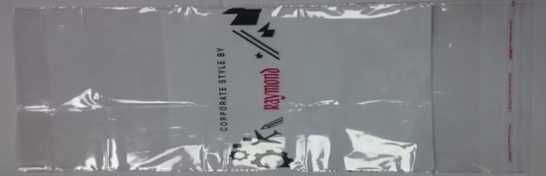


Jacket – Packing & Packaging Trims
SHIRT FOLDING & PACKING MATERIAL SPECIFICATION
Sr. No. | Material | Specification | Required qty. per Garment / Placements | Image
1 | Polybag | - | 1 pc
2 | Size Sticker | - | 1 pc / On the Polybag at hanger back
3 | Jacket Cover | - | 1 pc
4 | Carton | Length 39.3” * Width 22.8” * Height 8.6” / 7 ply with hard pasting and good quality paper to be use | 6 pcs per carton
8.6”
22.8”
39.3”

Slide 25
Jacket – Plastic polybag Mandate
Instruction :
All Polybags needs to be upgraded to 55 microns with below note at back of Polybag :
This bag is mfg & mkt by : Address, phone no, & email id
This bag is made of 100% virgin material & is 100% recyclable. Above 51+ microns.
License no :
This bag is for Industrial and Integral Packaging Only. Buy Back price for empty clean bags Rs.15/- per kg
PRINT PLACEMENT :
Vertical Placement of print – 6.5” from bottom
Horizontal Placement of print – 5.5” from sides

Slide 26
Jacket – Packing Sequence
STEP-1 [Hang the Jacket on Hanger] | STEP-2 [Attach Hangtag with Barcode] | STEP-3 [Put inside Polybag & Stick Size]

Slide 27
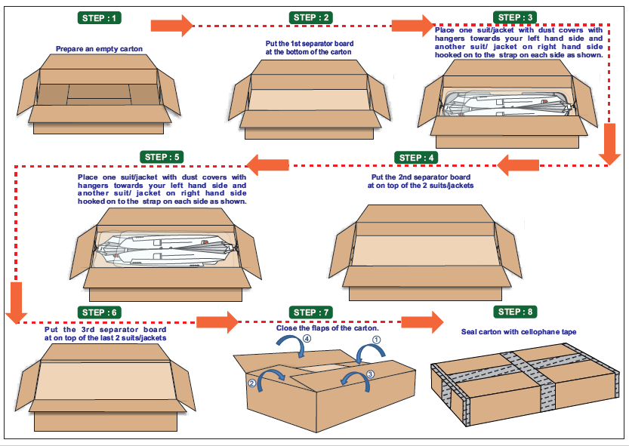
Jacket – Packaging Sequence

Slide 28
Jacket – Packaging Sequence
STEP-9 [Close & tape the carton and place carton sticker at center of width of carton]

Slide 29
Thank You

